Slide 1
Lecture 1: Introduction
许志钦
2023年12月10日

Slide 2
01
Using machine learning algorithms, e.g., deep learning, and traditional machine learning methods.
Goals
02
Understanding some mathematical mechanisms.
03
Coding algorithms to solve real problems.

Slide 3

Lecture 1: Introduction
神经网络简介
线性拟合
梯度下降与随机梯度下降
两层神经网络
向后传播
机器学习的基本概念
7. 一写常用的概念及符号
8. 常用的损失函数
9. 常用的优化算法
10. 训练中的一些问题
11. 神经网络研究的一些问题
12. 深度学习的历史简介

Slide 4

神经网络简介
01

Slide 5
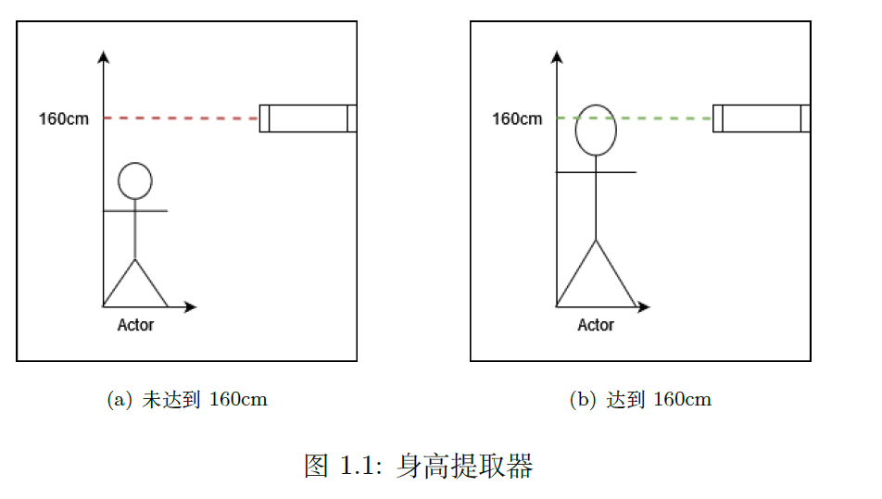
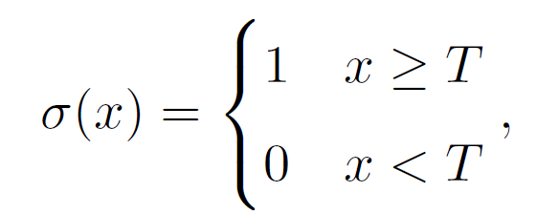
单个神经元如何感知信息
感知信息的基本条件是对不同的输入能够区分

Slide 6
单个神经元如何感知信息
一个预测股票升降的例子：
假设A 有两个朋友，B 和C。A 自己有一个判断值$a_{0}$，同时接收到了B和C的信息，分别记为$b和c$。因此，
如果B是一个经济学家，而C 是一个普通人，则有，$λ_{1}>λ_{2}>0$。

Slide 7
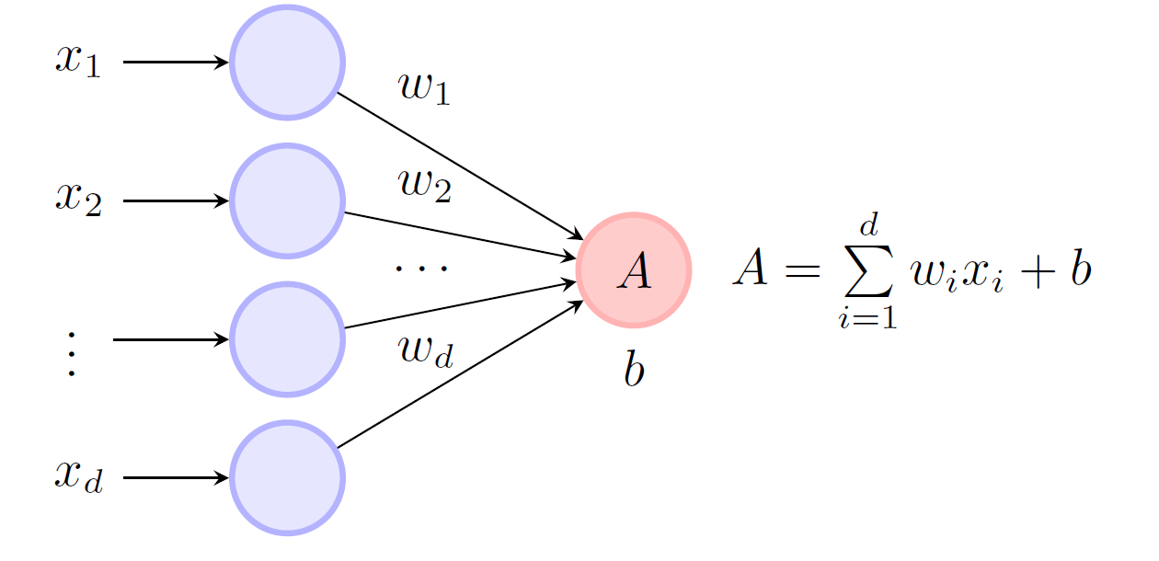
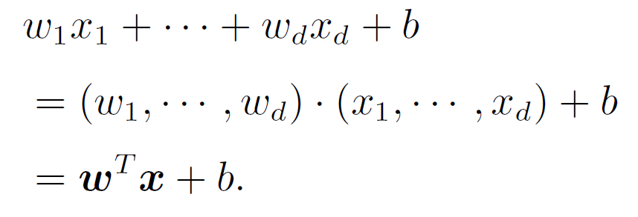
单个神经元如何感知信息：权重
我们可以把这类收集信息的方式推广到一般的形式
单个神经元的输出为

Slide 8
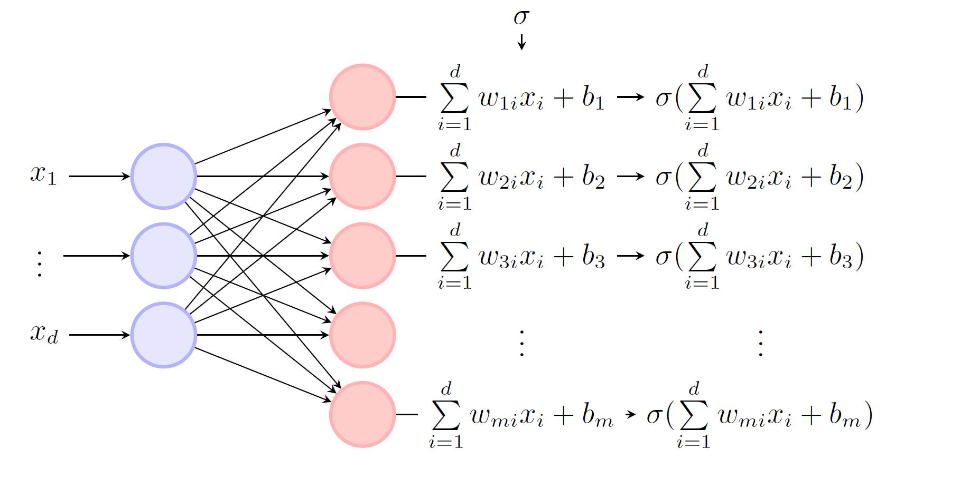
单层神经网络
简单地把多个神经元堆在一起，我们就可以得到单层神经网络

Slide 9
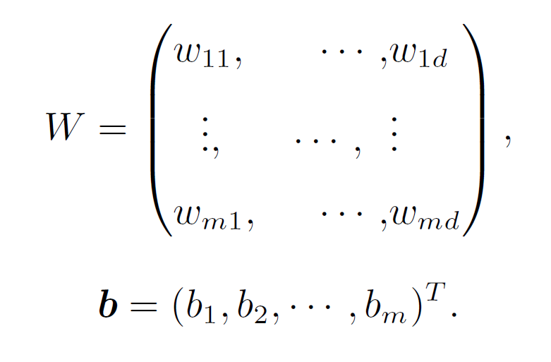
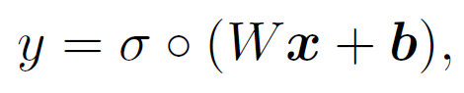

单层神经网络：矩阵形式
单层神经网络
参数的矩阵形式
神经网络的高维输出：
$∘$ 表示对每个元素作用：

Slide 10
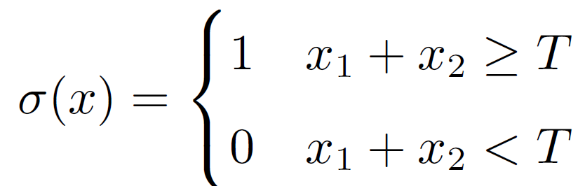



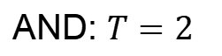
单层神经网络：设计功能
考虑输入是两维的，$x_{1},x_{2}∈{\{0,1\}}^{2}$
AND: $T=2$
Or: $T=1$
Not: $T=$0
$$σ\left(x\right)=−x$$
The Dartmouth Conference of 1956 was organized by Marvin Minsky, John McCarthy and two senior scientists: Claude Shannon and Nathan Rochester of IBM. The proposal for the conference included this assertion: "every aspect of learning or any other feature of intelligence can be so precisely described that a machine can be made to simulate it".

Slide 11
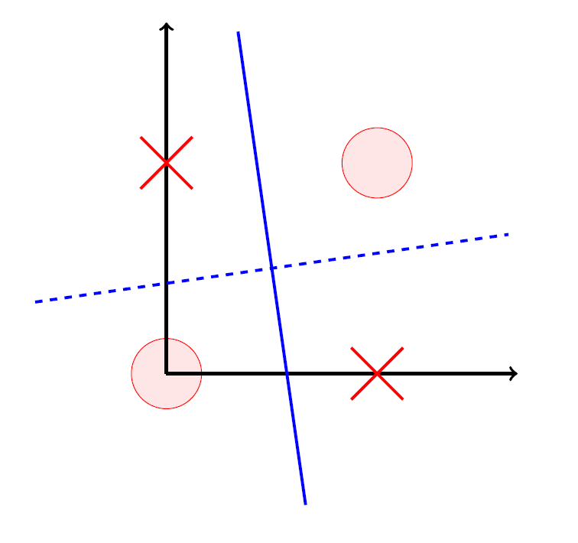
单层神经网络：局限性
单层神经网络是无法做好XOR问题，

Slide 12
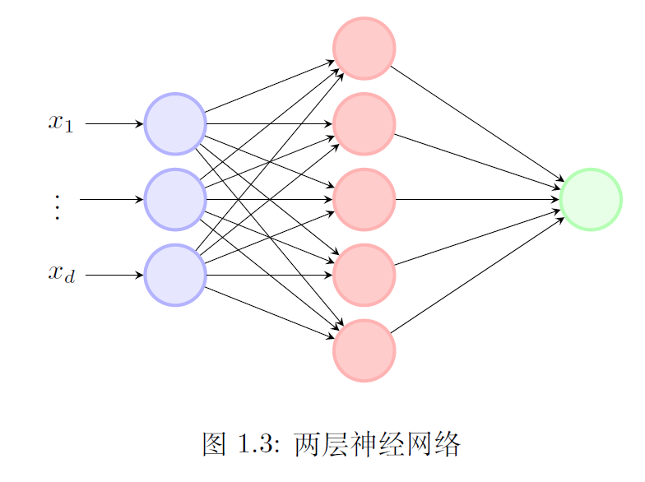
多层神经网络
多层神经网络是在一层神经网络的基础上堆叠起来的。

Slide 13
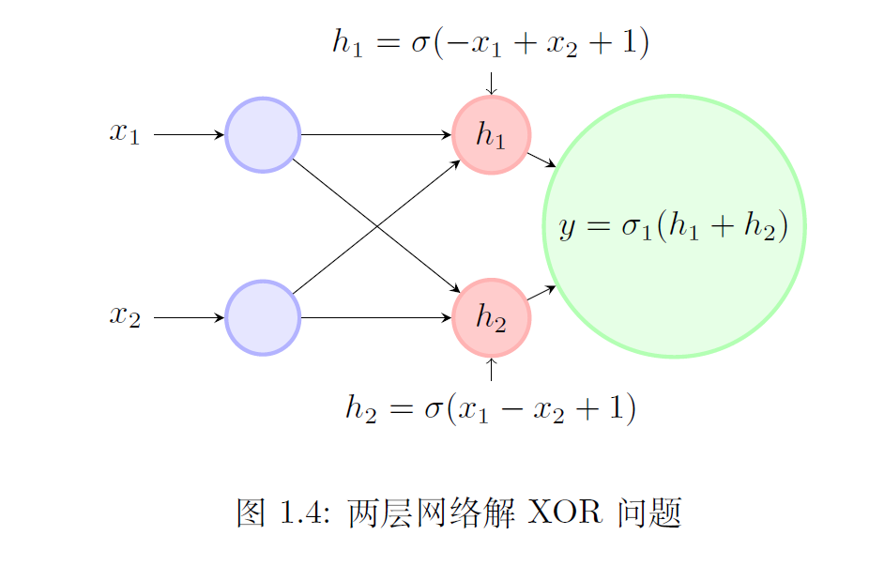
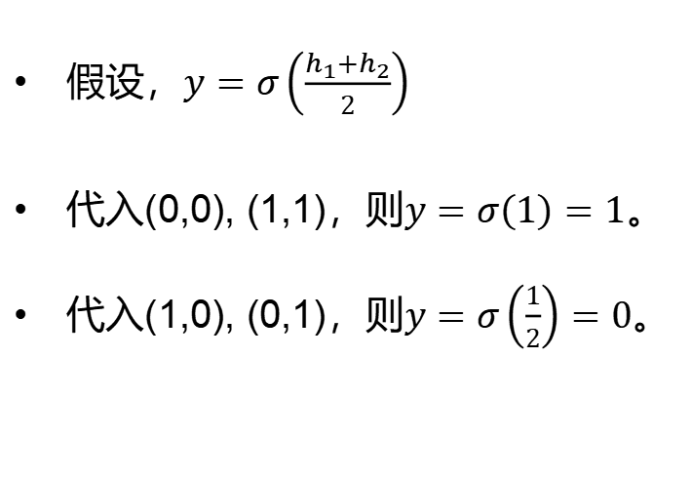
多层神经网络：解XOR问题
假设，$y=σ\left(\frac{h_{1}+h_{2}}{2}\right)$
代入(0,0), (1,1)，则$y=σ\left(1\right)=1$。
代入(1,0), (0,1)，则$y=σ\left(\frac{1}{2}\right)=0$。

Slide 14

多层神经网络
两层网络具有万有逼近定理（Cybenko 1989）
激活函数是非多项式的非线性函数
多项式函数是否有万有逼近定理？
为什么激活函数不能是多项式函数？
万有逼近定理对实际问题有什么帮助？
万有逼近定理是否足够让我们使用神经网络？
多层神经网络只是众多机器学习方法中的一种！

Slide 15

线性拟合
02

Slide 16
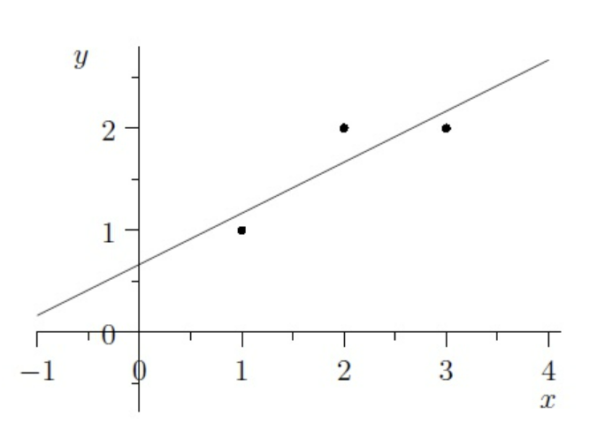
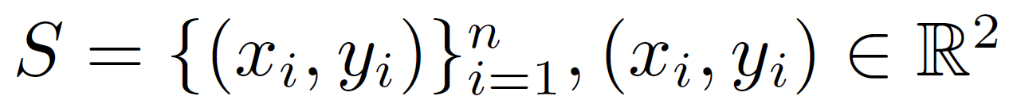
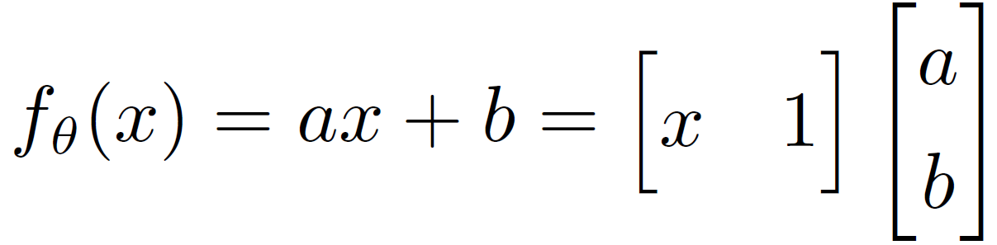
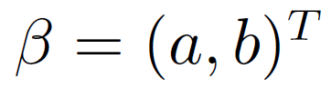
线性拟合
统计和机器学习(Machine learning, ML) 在数据挖掘中都有应用，用一个直观但并不是很严谨的方法去解释它们区别就是：统计是基于模型假设的，而机器学习是不需要模型基础的。本节中我们会用一个线性模型去理解它们的区别。

Slide 17
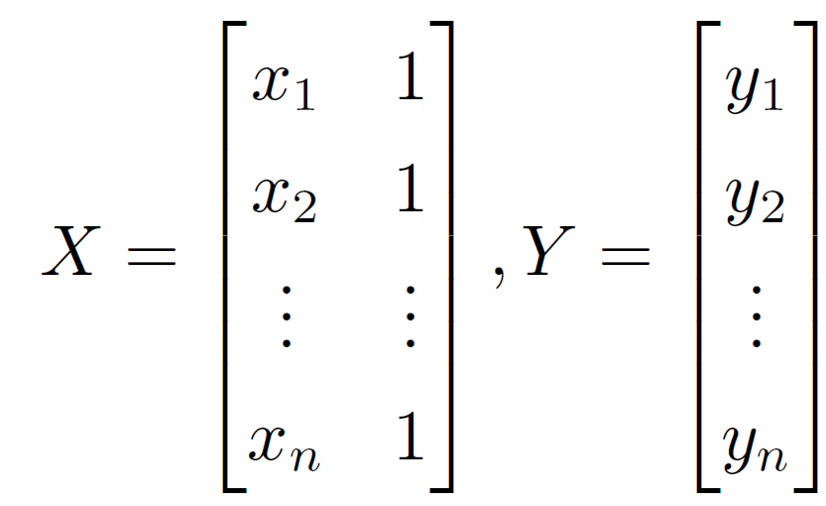
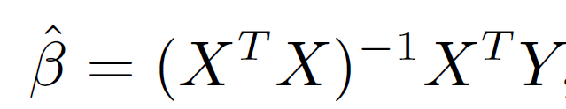
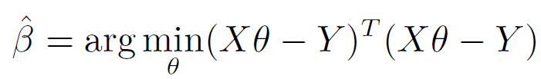
线性拟合：统计的角度
用线性模型拟合训练数据，
一个特殊的模型，

Slide 18
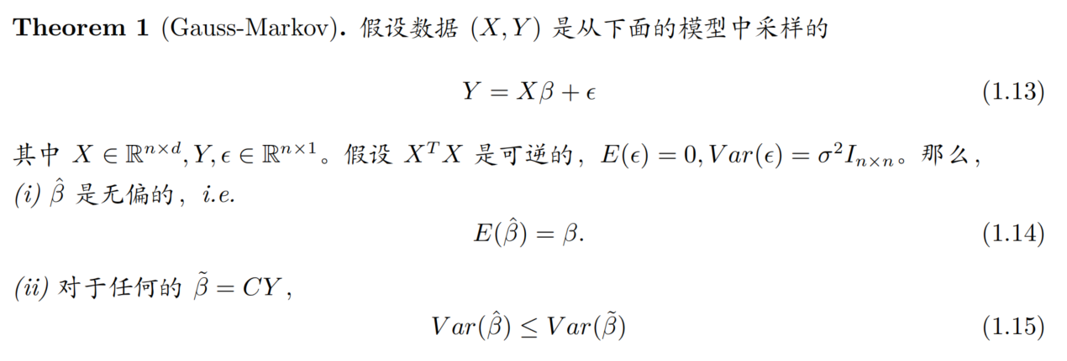
统计的角度：高斯-马尔可夫定理

Slide 19
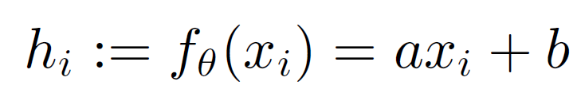
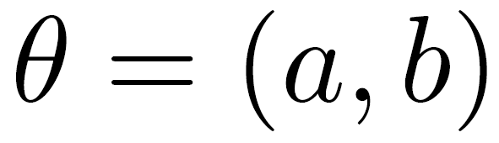
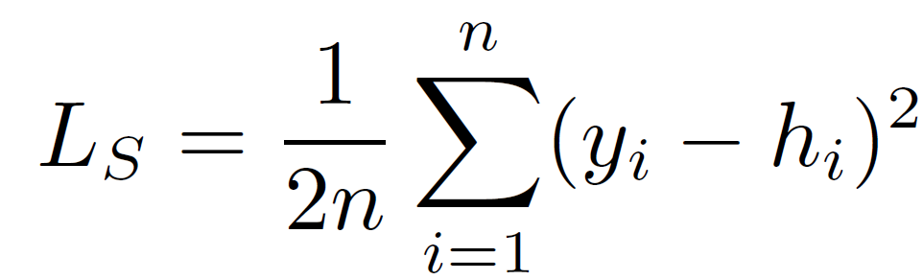
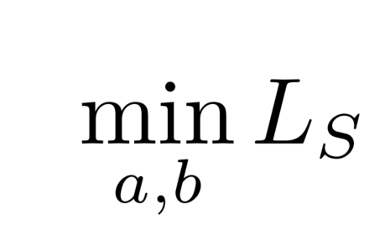
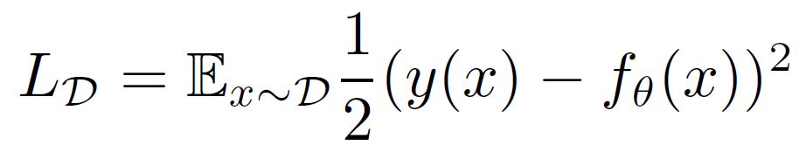
线性拟合：机器学习的角度
训练拟合：
线性模型拟合，
一种用的比较广泛的损失函数是均方差，
最小化训练误差，
我们关心的其实是泛化误差(generalization error)，也就是那些没有被用来训练的测试集上的误差，

Slide 20
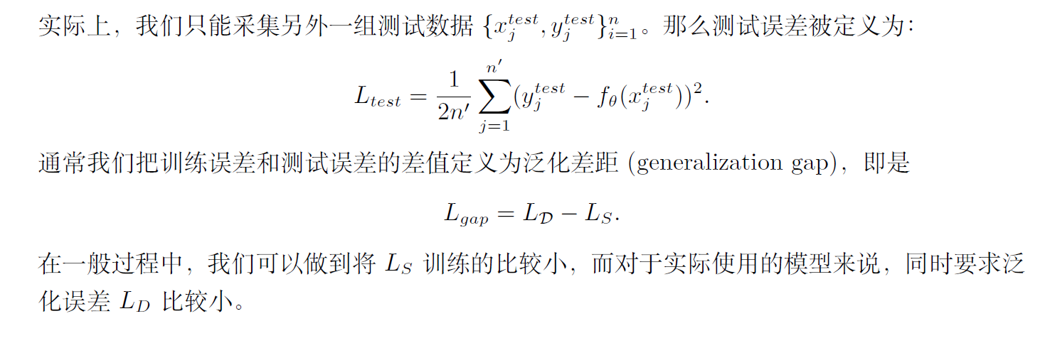
机器学习角度下的线性拟合：训练拟合

Slide 21
统计与机器学习的区别：区分意义不大
统计学习：从一个数据模型中去找一个合适的学习方法
无训练过程
对数据模型有假设
通过观测数据算参数
对误差有一定的保证
迁移性比较差
机器学习：一个学习方法去尽量的学习更多的数据模型
不需要对数据模型有太多的假设
有一套标准的流程
重要的方面在于选择一个合适的假设函数空间
一个足够复杂的学习方法，其方法的特征可以被多种超参数所调节
为了理解为什么一个机器学习方法有效，我们需要类似统计学习的方式去证明这类机器学习方法在某些超参数下能学习好什么样的数据。我们希望能有一个强大的机器学习方法，同时又有解释性。因此，区分“机器学习角度”或者“统计学习角度”的意义并不很大。

Slide 22
梯度下降
03

Slide 23
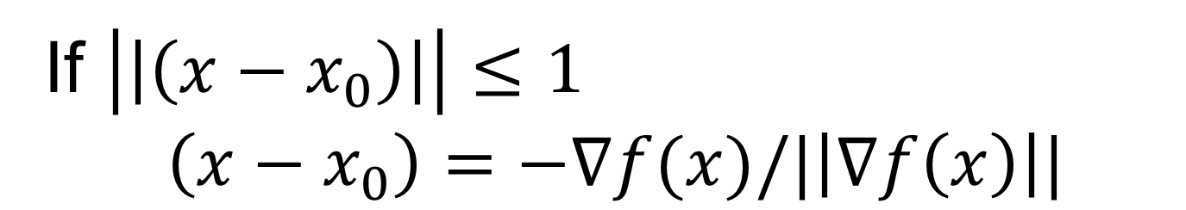
梯度下降
$f\left(x\right)≈f\left(x_{0}\right)+∇f\left(x\right)⋅(x−x_{0})$
If $\left|\left|\left(x−x_{0}\right)\right|\right|≤1$
$$\left(x−x_{0}\right)=−∇f(x)/|\left|∇f\left(x\right)\right||$$
下降最快！

Slide 24

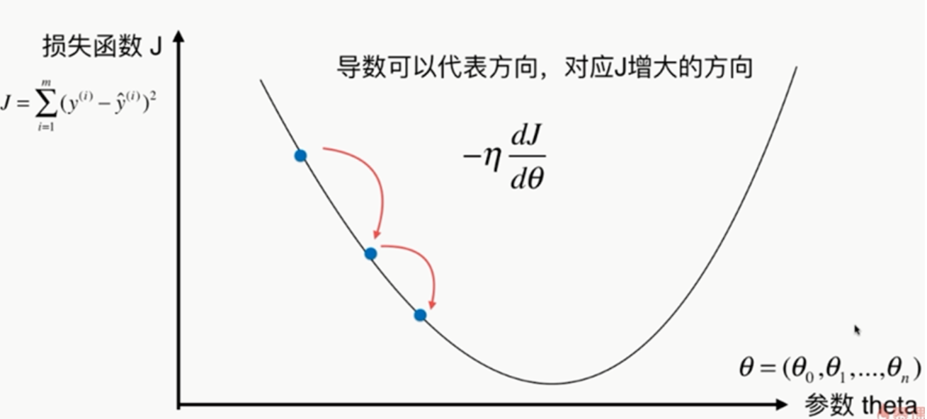
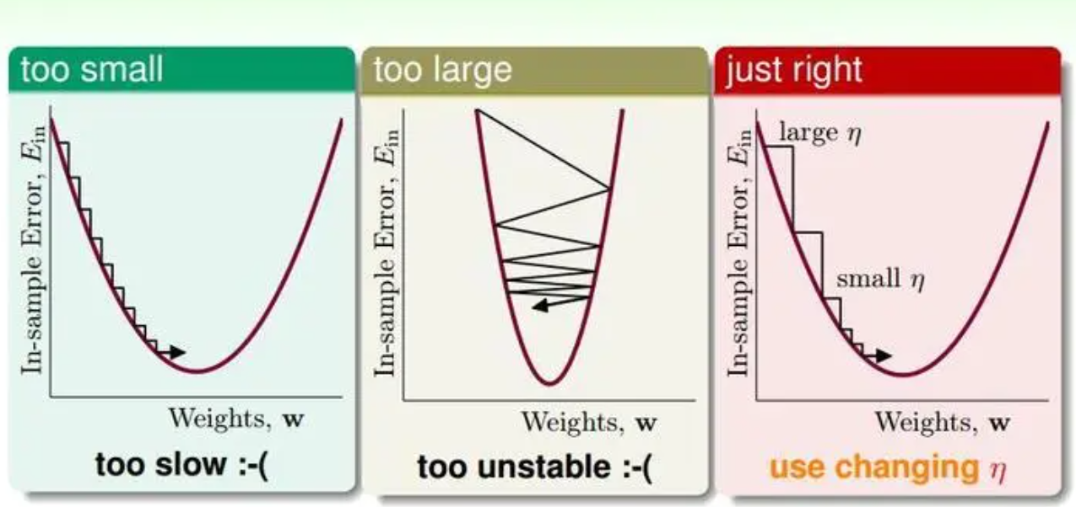
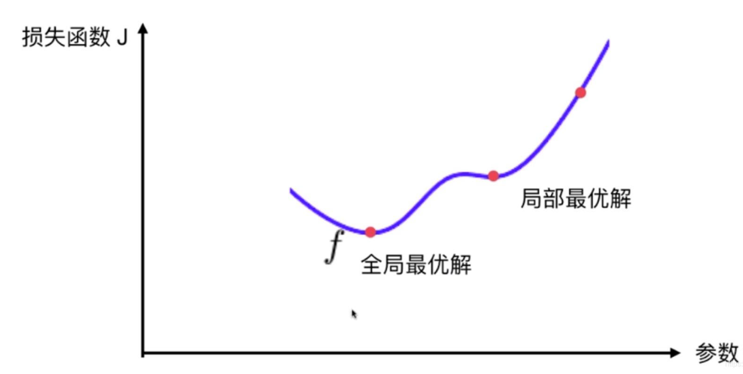
梯度下降
局部方法：依赖初始值

Slide 25
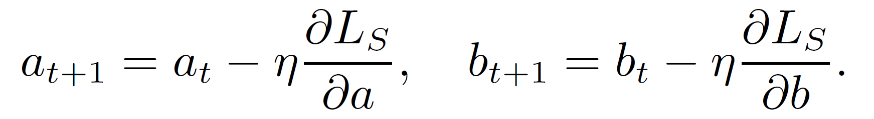
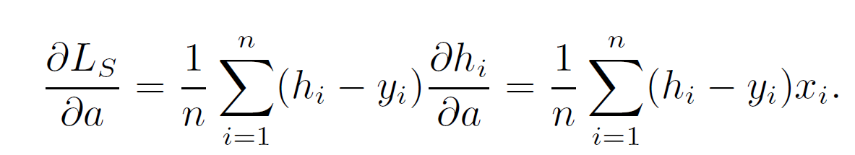
梯度下降：训练拟合线性模型
线性模型拟合，
一种用的比较广泛的损失函数是均方差，
最小化训练误差，
梯度下降：η 为学习步长（step size 或叫学习率，learning rate）

Slide 26
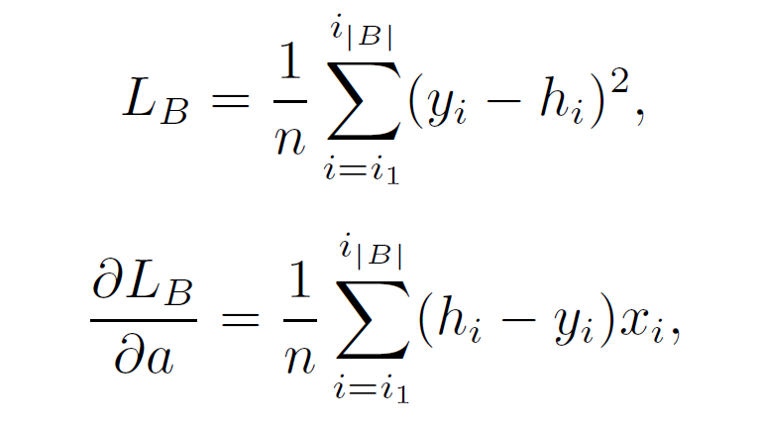
随机梯度下降
如果我们随机的从所有样本中选取 |B| 个样本来估计损失函数，即

Slide 27
两层神经网络
04

Slide 28
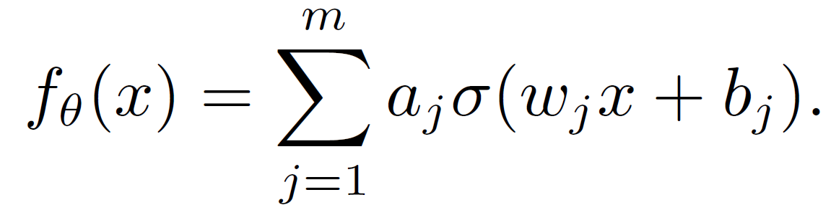
两层神经网络
假设数据集为${\{(x_{i},y_{i})\}}_{i=1}^{n}$，考虑一个只有一层隐藏层的神经网络，即两层神经网络，

Slide 29
向后传播
05

Slide 30
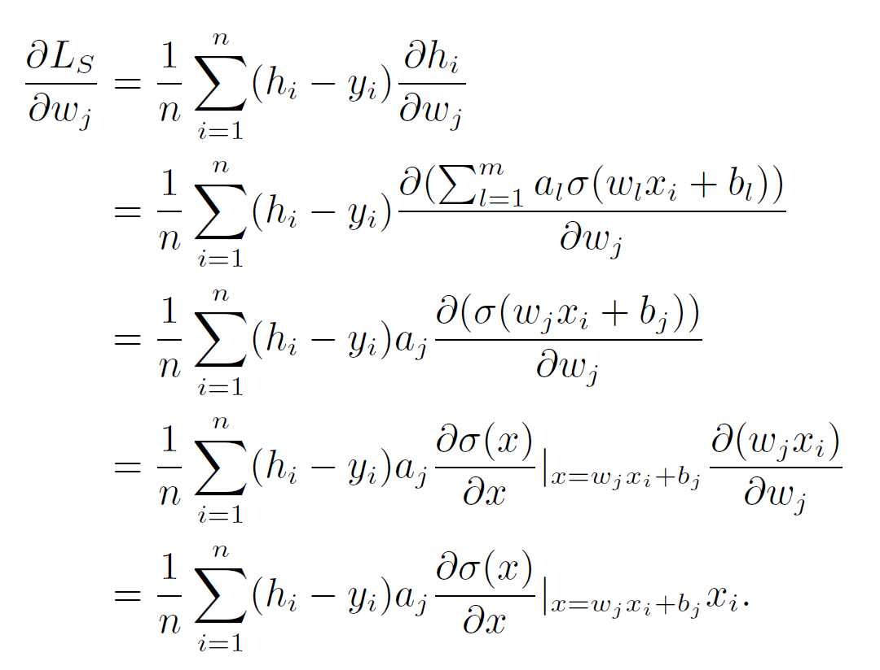
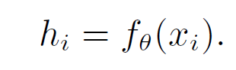
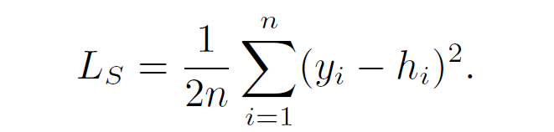
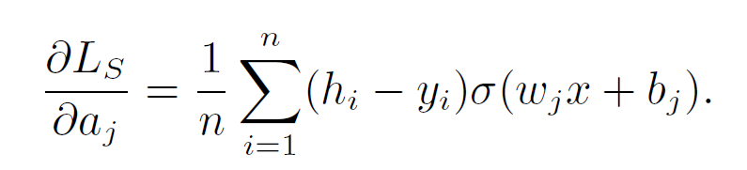

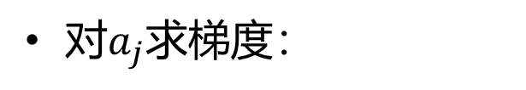
向后传播方法：两层神经网络
两层神经网络：
对$w_{j}$求梯度：
简记为：
均方差损失函数：
对$a_{j}$求梯度：

Slide 31
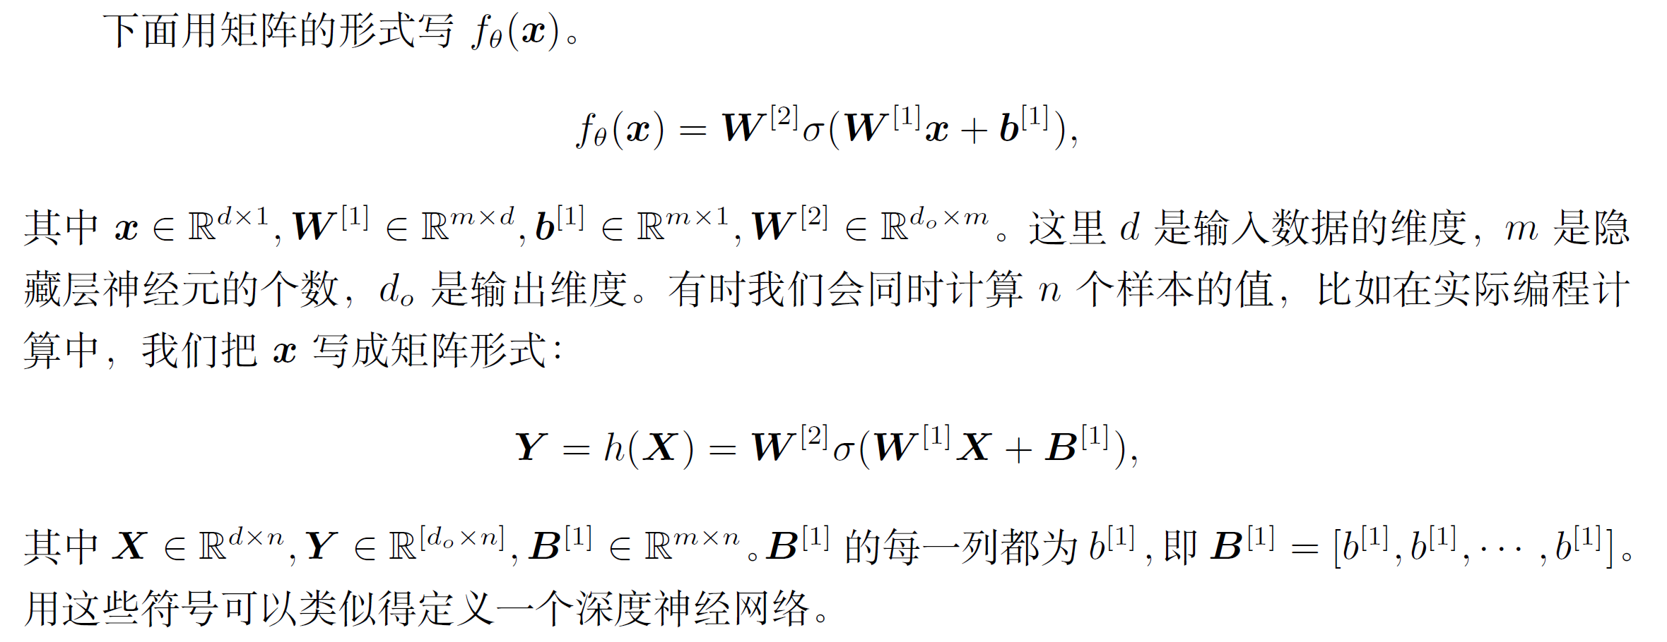
向后传播：矩阵形式

Slide 32

机器学习的基本概念
06

Slide 33
基本概念
Machine learning consists of three major components:
supervised learning, learning with labels
unsupervised learning (clustering, dimension reduction, generative models and density estimation)
reinforcement learning, learning to make optimal decisions in a dynamical system
In this course, we focus on the supervised learning.

Slide 34
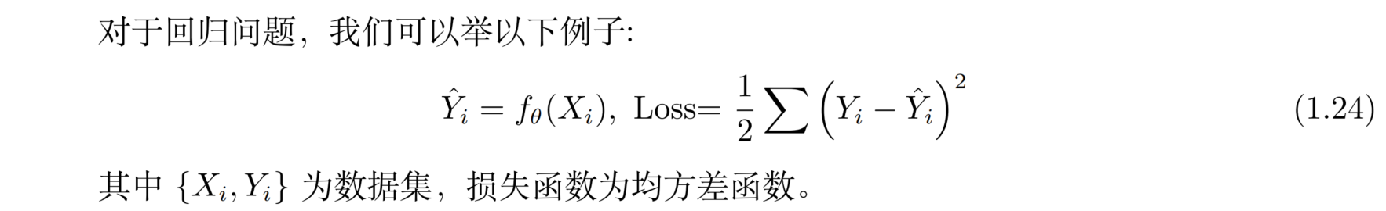
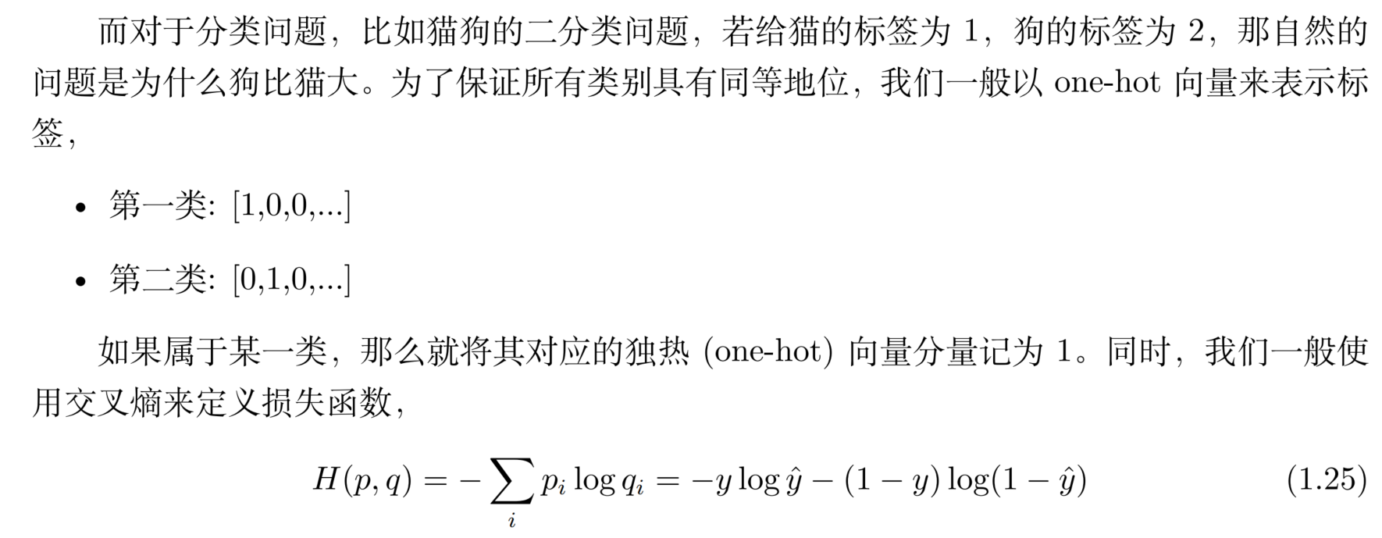
回归问题与分类问题

Slide 35
一些常用的概念及符号
07

Slide 36
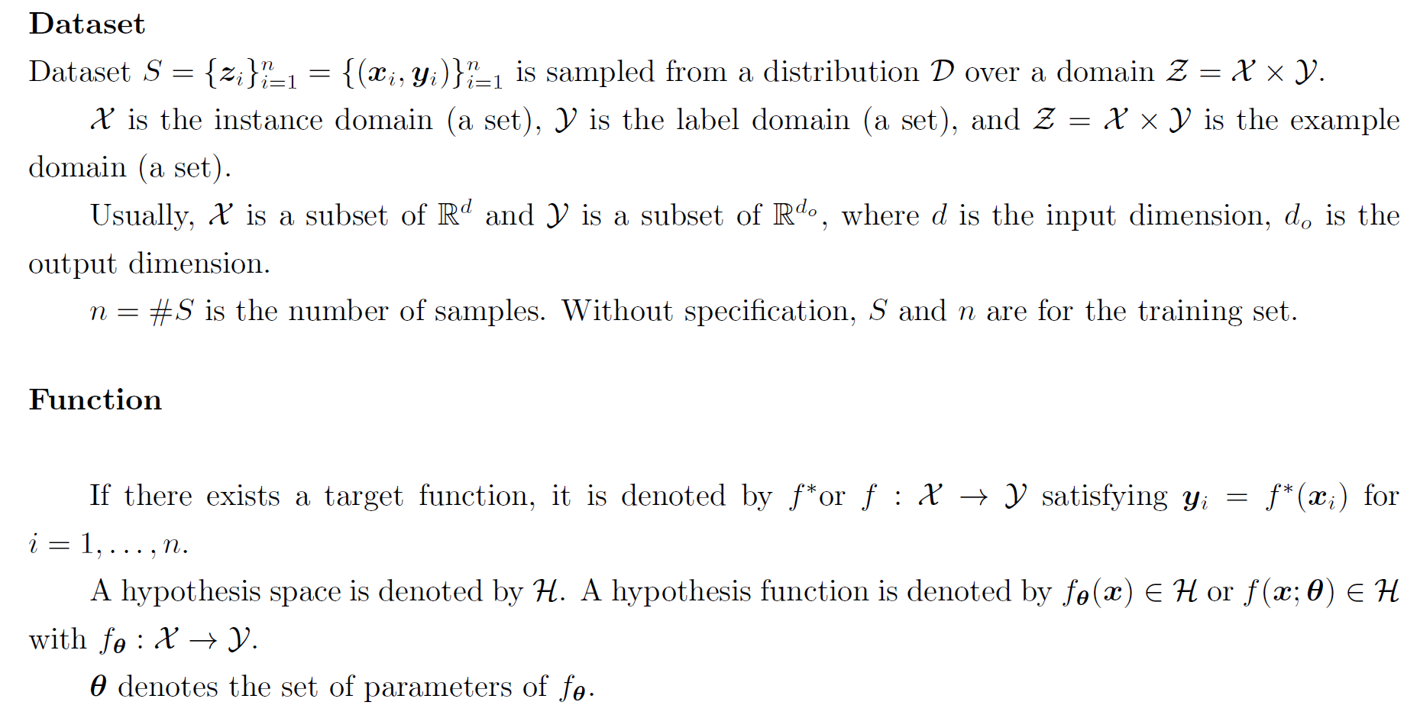
Dataset and Function

Slide 37
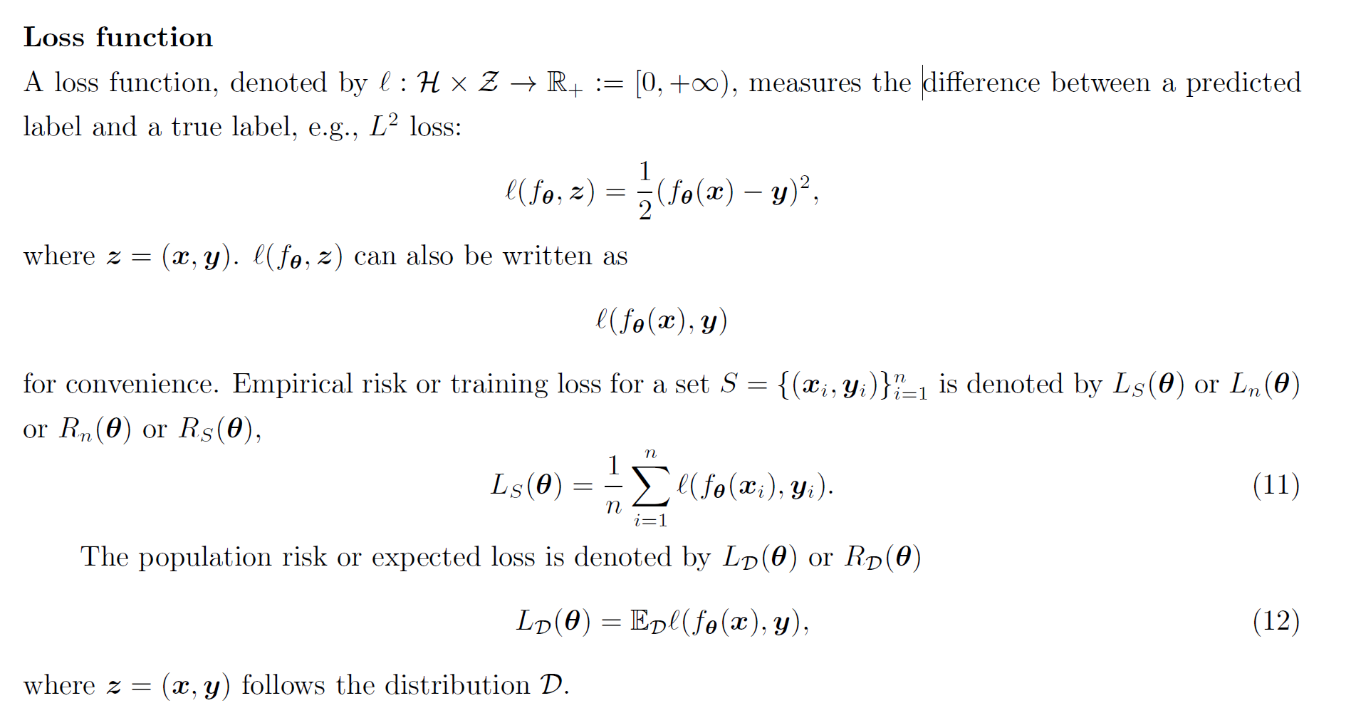
Loss Function

Slide 38
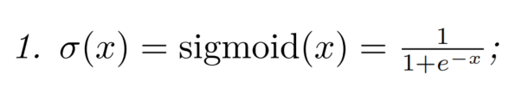
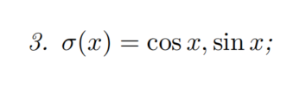
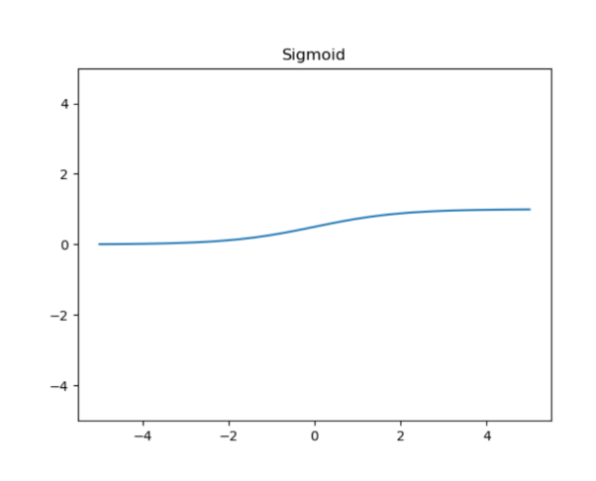
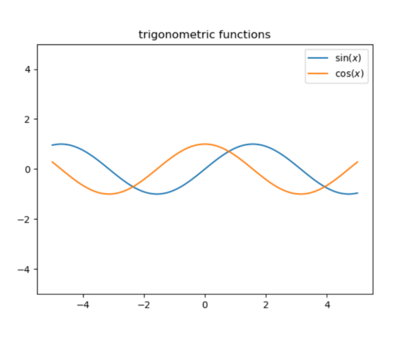
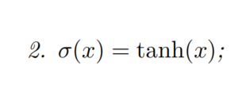



激活函数：$σ(x)$
一些常用的激活函数

Slide 39

两层神经网络：

Slide 40

一般神经网络：

Slide 41

Homework
With such notations, a deeper neural networks can be similarly defined.
Homework:
Derive BP for general network.
program a universal approximation function.

Slide 42
常用的损失函数
08

Slide 43




均方误差损失：高斯分布下，在最大似然角度下最合理的损失函数的形式
MSE可以表达成
假设误差服从标准高斯分布，则给定一个$x_{i}$模型输出真实值$y_{i}$的概率为
进一步假设采样独立，则所有样本呢的联合概率为
考虑对数似然函数Log-Likelihood
最大化对数似然函数等价于最小化 MSE。

Slide 44




绝对误差损失：标准拉普拉斯分布下，在最大似然角度下最合理的损失函数的形式
MAE可以表达成
假设误差服从标准拉普拉斯分布，则给定一个$x_{i}$模型输出真实值$y_{i}$的概率为
进一步假设采样独立，则所有样本呢的联合概率为
考虑对数似然函数Log-Likelihood
最大化对数似然函数等价于最小化 MAE。

Slide 45

交叉熵
在分类问题中，交叉熵 (Cross-Entropy) 比 MSE 或者 MAE 都更加常用，主要的原因是在分类问题中，模型的输出往往具有概率的解释。
Cross-Entropy可以表达成

Slide 46
常用的优化方法
09

Slide 47

常用的优化方法
Gradient Descent (GD)

Slide 48

常用的优化方法
Momentum
（动量）

Slide 49

常用的优化方法
Nesterov

Slide 50


常用的优化方法
Adagrad
（自适应学习率）

Slide 51

常用的优化方法
Avoid too small step size
Adadelta

Slide 52

常用的优化方法
Adam
（综合动量和自适应学习率）

Slide 53






常用的优化方法
Gradient Descent (GD)
Adagrad
（自适应学习率）
Momentum
（动量）
Adadelta
Nesterov
Adam
（综合动量和自适应学习率）

Slide 54
训练中的一些问题
10

Slide 55



参数的初始化
Lecun Initializatioin
Xavier Initialization
Kaiming Initialization

Slide 56



梯度消失及残差连接
梯度消失
残差连接

Slide 57



学习率与训练不稳定性
$$L=\frac{1}{2}λθ^{2}$$
$$θ_{t+1}=θ_{t}−η\frac{∂L}{∂θ}$$
$$=θ_{t}−ηλθ_{t}$$
$$=\left(1−ηλ\right)θ_{t}$$
Stable:
$$\left|θ_{t+1}\right|<\left|θ_{t}\right|$$
$$\left|1−ηλ\right|<1$$
$$−1<1−ηλ<1$$
$$ηλ<2$$
$$η<\frac{2}{λ}$$
$λ$ is eigen-value of Hessian for high-dim problem
https://www.enjoyalgorithms.com/blog/loss-and-cost-functions-in-machine-learning
Edge of stability
Wu, Ma, E, NeurIPS, 2018

Slide 58
神经网络研究的一些问题
11

Slide 59




误差分析、多层网络的优势、高维问题、训练
What are the most important problems in this field
$$f_{tar}$$
Error analysis
Approximation error
Generalization error
Training error
Multiple layers: what is the advantage of multiple layers?
High-dimensional problems (overcome curse of dimensionality)
Huge number of parameters: why algorithms can find good solutions in large para space?
Hypothesis set
App err
$$h_{D}$$
$$h$$
$$h_{s}$$
train err
gen err

Slide 60

Curse of dimensionality

Slide 61

Curse of dimensionality

Slide 62


Curse of dimensionality

Slide 63


Curse of dimensionality
Reading:

Slide 64
深度学习的历史简介
12

Slide 65





What AI can do?
massive investments from industry giants such as Google, and exponential growth in research publications

Slide 66
它是谁？
它从哪里来？
它将到哪里去？
Reference:
http://www.andreykurenkov.com/writing/ai/a-brief-history-of-neural-nets-and-deep-learning/

Slide 67

https://beamandrew.github.io/deeplearning/2017/02/23/deep_learning_101_part1.html

Slide 68

A Neuron Structure

Slide 69


Perform complex tasks
Notes:
https://towardsdatascience.com/mcculloch-pitts-model-5fdf65ac5dd1
http://www.andreykurenkov.com/writing/ai/a-brief-history-of-neural-nets-and-deep-learning/

Slide 70


仿生 : McCulloch-Pitts Neuron/Perceptron
The very first step towards the perceptron we use today was taken in 1943 by McCulloch and Pitts, by mimicking the functionality of a biological neuron.
Logic operation with 2d input
AND: x, T=2,
OR : x, T=1
NOT : -x+1, T=1
$$y=\left\{\begin{aligned}1, wx+b≥T \\ 0,wx+b<T\end{aligned}\right.$$
"A Logical Calculus of Ideas Immanent in Nervous Activity" (1943).
Notes:
MuCulloch (neuroscientist) and Walter Pitts (logician) in 1943

Slide 71

Dartmouth Conference 1956: the birth of AI
The Dartmouth Conference of 1956 was organized by Marvin Minsky, John McCarthy and two senior scientists: Claude Shannon and Nathan Rochester of IBM. The proposal for the conference included this assertion: "every aspect of learning or any other feature of intelligence can be so precisely described that a machine can be made to simulate it".
HOWEVER, The M-P neuron cannot learn from data!

Slide 72


Hebb’s rule: firing together, wiring together
Donald Hebb
“When an axon of cell A is near enough to excite a cell B and repeatedly or persistently takes part in firing it, some growth process or metabolic change takes place in one or both cells such that A’s efficiency, as one of the cells firing B, is increased.”
$$Δw=ηx_{i}x_{j}$$

Slide 73



Frank Rosenblatt’s Perceptron
$$f\left(x\right)=\left\{\begin{aligned}1, x>T \\ 0, x≤T\end{aligned}\right.$$
$$y_{j}=f\left(\sum_{i=1}^{n}{w_{i}x_{j,i}}\right)$$
$$w_{i}\left(t+1\right)=w_{i}\left(t\right)+η\left(d_{j}−{y_{j}}_{ }\right)x_{j,i}$$
When learning, regard $f\left(x\right)$ as a linear transform, drop non-linearity
$$w_{i}\left(t+1\right)=w_{i}\left(t\right)+η\frac{df}{dx}\left(d_{j}−{y_{j}}_{ }\right)x_{j,i}$$
Wiki

Slide 74

Hardware implementation
In a 1958, based on Rosenblatt's statements, The New York Times reported the perceptron to be "the embryo of an electronic computer that [the Navy] expects will be able to walk, talk, see, write, reproduce itself and be conscious of its existence."
见得风，是个雨
'Mark I Perceptron at the Cornell Aeronautical Laboratory', hardware implementation of the first Perceptron (Source: Wikipedia / Cornell Library)

Slide 75


Threshold is not differentiable
Bernard Widrow and Tedd Hoff soon explored the option of just outputting the weight input in 1960 with “An adaptive “ADALINE” neuron using chemical “memistors” (Adaptive linear neuron）

Slide 76
AI Winter
Conclusion of book “Perceptrons” by Minsky and Papert:
We need to use MLPs [multilayer perceptrons] even to represent simple nonlinear functions such as the XOR mapping.
No one on earth had found a viable way to train MLPs good enough to learn such simple functions.

Slide 77

Backpropagation
Backpropagation was derived by multiple researchers in the early 60’s and implemented to run on computers much as it is today as early as 1970 by Seppo Linnainmaa
But Paul Werbos was first in the US to propose that it could be used for neural nets after analyzing it in depth in his 1974 PhD Thesis

Slide 78

Paul Werbos
“But the pessimism at that time became terminal. In the early 1970s, I did in fact visit Minsky at MIT. I proposed that we do a joint paper showing that MLPs can in fact overcome the earlier problems … But Minsky was not interested. In fact, no one at MIT or Harvard or any place I could find was interested at the time.”
也许是差一个程序员！

Slide 79


AI 重回视线
Werbos did not publish on the application of backprop to neural nets until 1982 due to the chilling effects of the AI Winter.
Hopfield neural network, 1982,
associate memory
Hebb’s rule
Many local minima, $X_{a},X_{b}, ⋯$, If start from $X=X_{a}+Δ$, (Partial Information), it will evolve to $X_{a}$.

Slide 80



Slide 81
Comments
The paper even explicitly mentions David Parker and Yann LeCun as two people who discovered it beforehand
The 1986 publication stands out for how concisely and clearly the idea is stated
Their paper is essentially identical to the way the concept is still explained in textbooks and AI classes.
But the three authors went much further. They show how multilayer neural nets could be trained to tackle complex learning problems. And so, neural nets were back!

Slide 82
Almost no theory

Slide 83


Universal Approximation Theorem
Neural networks with a single hidden layer can be used to approximate any continuous function to any desired precision.
Cybenko 89, Hornik 89, Hornik 91, Barron 93
Requirement for transfer function:
$σ(z)$is well-defined as$z→−∞$and $z→∞$
$$\left|f(x)−\sum_{j}{k_{j}σ\left(w_{ij}x_{i}+b_{j}\right)}\right|<ε$$
Sketch of a constructive proof:
1. Construct Heaviside function from the given transfer function
2. Construct “bump” function (1-d) or “tower” function (2-d)
3. Approximate the target continuous function with “bump” or “tower” functions
Ref: http://neuralnetworksanddeeplearning.com/chap4.html

Slide 84





Slide 85
However
This is mathematics, imagine endless memory and computation power, and no learning considered!
XOR is simple, real data is complex
Can BP work for real data?

Slide 86

BP did work: Convolutional Neural Network
In 1989, Yann LeCun et al. demonstrated a very significant real-world application of backpropagation in "”Backpropagation Applied to Handwritten Zip Code Recognition”

Slide 87

MNIST dataset, Lecun 98
Training set: 60000
Test set: 10000
Size-normalized & centered
Resolution: 28*28 (784)
Linear classifiers: 7%~12%
Nonlinear classifiers: 3%~4%
K-nearest-neighbors: 0.5%~5%
SVMs: 0.5%~1.4%
Neural nets: 0.35%~5%
Convolutional nets: 0.23%~1.1%

Slide 88

Neural Nets Go Unsupervised
Automating the rote and utterly uninteresting task of reading checks is a great instance of what Machine Learning can be used for. Perhaps a less predictable application? Compression.

Slide 89




Boltzmann Machines
Energy-based model, generative models
Ackley, D. H., Hinton, G. E., & Sejnowski, T. J. (1985). A learning algorithm for boltzmann machines*. Cognitive science, 9(1), 147-169.
Notes:
RBM可以看做是一个编码解码的过程，从可见层到隐藏层就是编码，而反过来从隐藏层到可见层就是解码。在推荐系统中，我们可以把每个用户对各个物品的评分做为可见层神经元的输入，然后有多少个用户就有了多少个训练样本。由于用户不是对所有的物品都有评分，所以任意样本有些可见层神经元没有值。但是这不影响我们的模型训练。在训练模型时，对于每个样本，我们仅仅用有用户数值的可见层神经元来训练模型。
对于可见层输入的训练样本和随机初始化的W,aW,a,我们可以用上面的sigmoid激活函数得到隐藏层的神经元的0,1值，这就是编码。然后反过来从隐藏层的神经元值和W,bW,b可以得到可见层输出，这就是解码。对于每个训练样本， 我们期望编码解码后的可见层输出和我们的之前可见层输入的差距尽量的小，即上面的对数似然损失函数尽可能小。按照这个损失函数，我们通过迭代优化得到W,a,bW,a,b，然后对于某个用于那些没有评分的物品，我们用解码的过程可以得到一个预测评分，取最高的若干评分对应物品即可做用户物品推荐了。

Slide 90

reinforcement learning
Control an inverted pendulum
Anderson, C. W. (1989). Learning to control an inverted pendulum using neural networks. Control Systems Magazine, IEEE, 9(3), 31-37.

Slide 91

Backgammon
one of the most significant results in the history of reinforcement learning was achieved: outperform humans on relatively complicated tasks: Backgammon
Tesauro, G. (1995). Temporal difference learning and TD-Gammon. Communications of the ACM, 38(3), 58-68.
Notes:
one of the most significant results in the history of reinforcement learning was achieved: a neural net that learned to be a world class backgammon player. Dubbed TD-Gammon, the neural net was trained using a standard reinforcement learning algorithm and was one of the first demonstrations of reinforcement learning being able to outperform humans on relatively complicated tasks

Slide 92

Not good at Chess
Sebastian Thrun in the 1995 “Learning To Play the Game of Chess”

Slide 93
A New Winter Dawns
BP did not work well (deep worse than shallow)
Backpropagation: ‘vanishing or exploding gradient problem’.
RNNs were particularly difficult to train with BP
Schmidhuber and Hochreiter, 1997, introduced Long Short Term Memory (LSTM).
The computers were not fast enough, the algorithms were not smart enough, and people were not happy.

Slide 94

A New Winter Dawns
Mid 90s, the community once again lost faith.
Support vector machine (SVM)
In fact, the 1995 LeCun et al. better or the same as all but the best designed neural nets.

Slide 95



A New Winter Dawns
LeCun and Hinton: their papers were routinely rejected due to subject being Neural Nets.
Still, they persevered.
And they found a strong ally: CIFAR, which encourages basic research without direct application, was what motivated Hinton to move to Canada in 1987

Slide 96
https://beamandrew.github.io/deeplearning/2017/02/23/deep_learning_101_part1.html

Slide 97

Breakthrough
Hinton, Simon Osindero, and Yee-Whye Teh published a paper in 2006 that was seen as a breakthrough, a breakthrough significant enough to rekindle interest in neural nets: A fast learning algorithm for deep belief nets
It turns out that this form of Boltzmann machine can be trained in an efficient manner introduced by Hinton in the 2002 “Training Products of Experts by Minimizing Contrastive Divergence”

Slide 98
Breakthrough
Hinton:
“Historically, this was very important in overcoming the belief that these deep neural networks were no good and could never be trained. And that was a very strong belief. A friend of mine sent a paper to ICML [International Conference on Machine Learning], not that long ago, and the referee said it should not accepted by ICML, because it was about neural networks and it was not appropriate for ICML. In fact if you look at ICML last year, there were no papers with ‘neural’ in the title accepted, so ICML should not accept papers about neural networks. That was only a few years ago. And one of the IEEE journals actually had an official policy of [not accepting your papers]. So, it was a strong belief.”
MNIST:
Hinton’s 2006: 1.25%
SVMs: 1.4%
1998 using CNNs: 0.95%
what was coming - in short, many more broken records.

Slide 99




Importance of Brute Force: GPU
Abdel-rahman Mohamed, George Dahl, and Hinton
Dahl had discovered how to train and simulate neural networks efficiently using GPU
Speech recognition, DBN, significantly better
Notes:
“Inspired by one of Hinton’s lectures on deep neural networks, Mohamed began applying them to speech - but deep neural networks required too much computing power for conventional computers – so Hinton and Mohamed enlisted Dahl. A student in Hinton’s lab, Dahl had discovered how to train and simulate neural networks efficiently using the same high-end graphics cards which make vivid computer games feasible on personal computers.
They applied the same method to the problem of recognizing fragments of phonemes in very short windows of speech,” said Hinton. “They got significantly better results than previous methods on a standard three-hour benchmark.””

Slide 100


Importance of Brute Force: GPU
Dahl and Mohamed’s use of a GPU
Intern at Microsoft Research
Three-month internship, and Microsoft Research has been at the forefront of deep learning speech recognition ever since.
Navdeep Jaitly, another student of Hinton’s
A summer internship at Google in 2011.
The revised approach soon powered Android’s speech recognition, replacing much of Google’s carefully crafted prior solution

Slide 101

Importance of Brute Force: GPU
the work by Microsoft and Google, as well as IBM and Hinton’s lab, resulted in the impressively titled “Deep Neural Networks for Acoustic Modeling in Speech Recognition: The Shared Views of Four Research Groups” in 2012.
If there was ever an ideal scenario for industry adopting an idea from research, this seems like it.

Slide 102




But it was perhaps not Hinton, but Andrew Ng who incited the company to become likely the world’s biggest commercial adopter and proponent of the technology. In 2011, Andrew Ng incidentally met with the legendary Googler Jeff Dean while visiting the company and chatted about his efforts to train neural nets with Google’s fantastic computational resources. This intrigued Dean, and together with Ng they formed Google Brain
Learned to recognize the most common objects
Google's famous neural-net learned cat. This is the optimal input to one of the neurons.
1 billion weights
unsupervised
Youtube videos, entirely without labels

Slide 103



Imagenet
14 million images, 20,000 categories
Fei-Fei Li

Slide 104
Imagenet
2006, Fei-Fei Li started ruminating on an idea.
Late 1980s, Princeton George Miller, WordNet
words shown in relation, e.g., 狗—犬类—哺乳动物
A large-scale dataset with many images of each word
Ph.D student Jia Deng, early 2007
Difficulties:
hire undergraduate, expensive
computer-vision algorithms unstable
only strength of proposal was that Li was a woman
Amazon Mechanical Turk
3.2 million labelled images, separated into 5,247 categories, sorted into 12 subtrees, 2009
“There were comments like ‘If you can’t even do one object well, why would you do thousands, or tens of thousands of objects?” Deng said.
ImageNet Large Scale Visual Recognition Competition, ILSVRC, 2010
https://qz.com/1034972/the-data-that-changed-the-direction-of-ai-research-and-possibly-the-world/

Slide 105

Why BP not work well in the past
Geoffrey Hinton summarized the findings up to today in these four points:
Our labeled datasets were thousands of times too small.
Our computers were millions of times too slow.
We initialized the weights in a stupid way.
We used the wrong type of non-linearity.
Deep Learning =Lots of training data + Parallel Computation + Scalable, smart algorithms

Slide 106

History changed
Geoffrey Hinton, Alex Krizhevsky and Ilya Sutskever, ILSVRC-2012,
combination of very old concepts
CNN+GPU+ReLU+Dropout+SGD
their error rate was %15.3, the second was %26.2.
“ImageNet Classification with deep convolutional neural networks” Geoffrey Hinton, Alex Krizhevsky and Ilya Sutskever, 2012
https://qz.com/1034972/the-data-that-changed-the-direction-of-ai-research-and-possibly-the-world/

Slide 107

Success of deep learning
https://www.linkedin.com/pulse/must-read-path-breaking-papers-image-classification-muktabh-mayank

Slide 108








Best accuracy
Image classification
Optical Character Recognition (OCR)
Text translation
Voice recognition
Lip reading
…
Even beat human performance!

Slide 109


Slide 110




Scientific problems
Slides from Prof. Weinan E
Notes:
Numerical and medical

Slide 111


Slide 112


2019 Fathers of the Deep Learning Revolution Receive ACM A.M.

Slide 113






What’s happened is happening?!?

Slide 114

Patel’s PPT, Stats 385 Stanford

Slide 115

Patel’s PPT, Stats 385 Stanford

Slide 116

Generation of “dog” with generative adversarial network (GAN)

Slide 117

Patel’s PPT, Stats 385 Stanford

Slide 118


Time to replace human being? Not yet!

Slide 119

anisotropic diffusion,
total variation,
energy minimization, manifold,
Beltrami flow,
low-rank approximation,
non-local means,
Bayesian estimation, robust statistics,
…
… Unfortunately, all of these great empirical achievements were obtained with hardly any theoretical understanding of the underlying paradigm. ...
…Today, deep learning treats many other image processing needs, with unsurpassed results. This is true for single image super-resolution, demosaicing, deblurring, segmentation, image annotation, and face recognition, among others. …

Slide 120
Thanks

